Slide 1
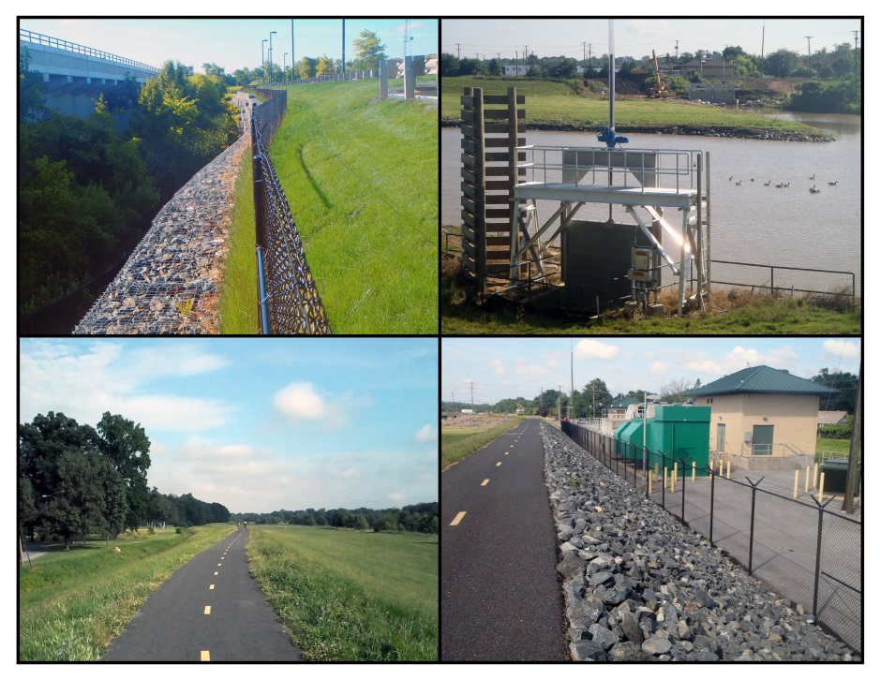
Anacostia Flood Risk Management Rehabilitation Project
CEAM Fall Conference
September 17-20, 2014
Rushern L. Baker, III
County Executive
Darrell B. Mobley
Director

Slide 2
Anacostia Flood Risk Management
Rehabilitation Project
Prince George’s County Department of Public Works and Transportation team included:
McCormick Taylor
Highway Safety Services
Concrete General, Inc.
Sagres Construction Corp.
JLW Associates
Alpha Corporation provided construction management services

Slide 3
Anacostia Flood Risk Management
Rehabilitation Project
Project Overview and Background
Project Goals
Design Elements
Construction
Sustainability

Slide 4
Anacostia Flood Risk Management
Rehabilitation Project
Background
U.S. Army Corps of Engineers (USACE) constructed the Anacostia Flood Risk Management Rehabilitation Project in the 1950s. The project included:
      Over 5 miles of Earthen Levees
      Four Flood Control Pumping Stations
      2,500 feet of 8x4 Twin Pressure Conduit

Slide 5
Anacostia Flood Risk Management
Rehabilitation Project
<?xml version="1.0"?><AllQuestions />
<?xml version="1.0"?><AllResponses />
<?xml version="1.0"?><Settings><answerBulletFormat>Numeric</answerBulletFormat><answerNowAutoInsert>No</answerNowAutoInsert><answerNowStyle>Explosion</answerNowStyle><answerNowText>Answer Now</answerNowText><chartColors>Use PowerPoint Color Scheme</chartColors><chartType>Horizontal</chartType><correctAnswerIndicator>Checkmark</correctAnswerIndicator><countdownAutoInsert>No</countdownAutoInsert><countdownSeconds>10</countdownSeconds><countdownSound>TicToc.wav</countdownSound><countdownStyle>Box</countdownStyle><gridAutoInsert>No</gridAutoInsert><gridFillStyle>Answered</gridFillStyle><gridFillColor>255,255,0</gridFillColor><gridOpacity>50%</gridOpacity><gridTextStyle>Keypad #</gridTextStyle><inputSource>Response Devices</inputSource><multipleResponseDivisor># of Responses</multipleResponseDivisor><participantsLeaderBoard>5</participantsLeaderBoard><percentageDecimalPlaces>0</percentageDecimalPlaces><responseCounterAutoInsert>No</responseCounterAutoInsert><responseCounterStyle>Oval</responseCounterStyle><responseCounterDisplayValue># of Votes Received</responseCounterDisplayValue><insertObjectUsingColor>Red</insertObjectUsingColor><showResults>Yes</showResults><teamColors>Use PowerPoint Color Scheme</teamColors><teamIdentificationType>None</teamIdentificationType><teamScoringType>Voting pads only</teamScoringType><teamScoringDecimalPlaces>1</teamScoringDecimalPlaces><teamIdentificationItem></teamIdentificationItem><teamsLeaderBoard>5</teamsLeaderBoard><teamName1></teamName1><teamName2></teamName2><teamName3></teamName3><teamName4></teamName4><teamName5></teamName5><teamName6></teamName6><teamName7></teamName7><teamName8></teamName8><teamName9></teamName9><teamName10></teamName10><showControlBar>All Slides</showControlBar><defaultCorrectPointValue>0</defaultCorrectPointValue><defaultIncorrectPointValue>0</defaultIncorrectPointValue><chartColor1>187,224,227</chartColor1><chartColor2>51,51,153</chartColor2><chartColor3>0,153,153</chartColor3><chartColor4>153,204,0</chartColor4><chartColor5>128,128,128</chartColor5><chartColor6>0,0,0</chartColor6><chartColor7>0,102,204</chartColor7><chartColor8>204,204,255</chartColor8><chartColor9>255,0,0</chartColor9><chartColor10>255,255,0</chartColor10><teamColor1>187,224,227</teamColor1><teamColor2>51,51,153</teamColor2><teamColor3>0,153,153</teamColor3><teamColor4>153,204,0</teamColor4><teamColor5>128,128,128</teamColor5><teamColor6>0,0,0</teamColor6><teamColor7>0,102,204</teamColor7><teamColor8>204,204,255</teamColor8><teamColor9>255,0,0</teamColor9><teamColor10>255,255,0</teamColor10><displayAnswerImagesDuringVote>Yes</displayAnswerImagesDuringVote><displayAnswerImagesWithResponses>Yes</displayAnswerImagesWithResponses><displayAnswerTextDuringVote>Yes</displayAnswerTextDuringVote><displayAnswerTextWithResponses>Yes</displayAnswerTextWithResponses><questionSlideID></questionSlideID><controlBarState>Expanded</controlBarState><isGridColorKnownColor>True</isGridColorKnownColor><gridColorName>Yellow</gridColorName></Settings>
<?xml version="1.0"?><AllAnswers />
Background, cont.
The project is owned and operated by Prince George’s County, DPW&T.
Residents and property owners located within seven municipalities are protected by the system.

Slide 6
Anacostia Flood Risk Management
Rehabilitation Project
Background, cont.
Annual levee system inspections were conducted by the County and USACE.
Levee maintenance and operation of flood control pumping stations was performed by the County.
A major improvement project to include the installation of three new screw pumps was completed in 2009.

Slide 7
Anacostia Flood Risk Management
Rehabilitation Project
<?xml version="1.0"?><AllQuestions />
<?xml version="1.0"?><AllResponses />
<?xml version="1.0"?><Settings><answerBulletFormat>Numeric</answerBulletFormat><answerNowAutoInsert>No</answerNowAutoInsert><answerNowStyle>Explosion</answerNowStyle><answerNowText>Answer Now</answerNowText><chartColors>Use PowerPoint Color Scheme</chartColors><chartType>Horizontal</chartType><correctAnswerIndicator>Checkmark</correctAnswerIndicator><countdownAutoInsert>No</countdownAutoInsert><countdownSeconds>10</countdownSeconds><countdownSound>TicToc.wav</countdownSound><countdownStyle>Box</countdownStyle><gridAutoInsert>No</gridAutoInsert><gridFillStyle>Answered</gridFillStyle><gridFillColor>255,255,0</gridFillColor><gridOpacity>50%</gridOpacity><gridTextStyle>Keypad #</gridTextStyle><inputSource>Response Devices</inputSource><multipleResponseDivisor># of Responses</multipleResponseDivisor><participantsLeaderBoard>5</participantsLeaderBoard><percentageDecimalPlaces>0</percentageDecimalPlaces><responseCounterAutoInsert>No</responseCounterAutoInsert><responseCounterStyle>Oval</responseCounterStyle><responseCounterDisplayValue># of Votes Received</responseCounterDisplayValue><insertObjectUsingColor>Red</insertObjectUsingColor><showResults>Yes</showResults><teamColors>Use PowerPoint Color Scheme</teamColors><teamIdentificationType>None</teamIdentificationType><teamScoringType>Voting pads only</teamScoringType><teamScoringDecimalPlaces>1</teamScoringDecimalPlaces><teamIdentificationItem></teamIdentificationItem><teamsLeaderBoard>5</teamsLeaderBoard><teamName1></teamName1><teamName2></teamName2><teamName3></teamName3><teamName4></teamName4><teamName5></teamName5><teamName6></teamName6><teamName7></teamName7><teamName8></teamName8><teamName9></teamName9><teamName10></teamName10><showControlBar>All Slides</showControlBar><defaultCorrectPointValue>0</defaultCorrectPointValue><defaultIncorrectPointValue>0</defaultIncorrectPointValue><chartColor1>187,224,227</chartColor1><chartColor2>51,51,153</chartColor2><chartColor3>0,153,153</chartColor3><chartColor4>153,204,0</chartColor4><chartColor5>128,128,128</chartColor5><chartColor6>0,0,0</chartColor6><chartColor7>0,102,204</chartColor7><chartColor8>204,204,255</chartColor8><chartColor9>255,0,0</chartColor9><chartColor10>255,255,0</chartColor10><teamColor1>187,224,227</teamColor1><teamColor2>51,51,153</teamColor2><teamColor3>0,153,153</teamColor3><teamColor4>153,204,0</teamColor4><teamColor5>128,128,128</teamColor5><teamColor6>0,0,0</teamColor6><teamColor7>0,102,204</teamColor7><teamColor8>204,204,255</teamColor8><teamColor9>255,0,0</teamColor9><teamColor10>255,255,0</teamColor10><displayAnswerImagesDuringVote>Yes</displayAnswerImagesDuringVote><displayAnswerImagesWithResponses>Yes</displayAnswerImagesWithResponses><displayAnswerTextDuringVote>Yes</displayAnswerTextDuringVote><displayAnswerTextWithResponses>Yes</displayAnswerTextWithResponses><questionSlideID></questionSlideID><controlBarState>Expanded</controlBarState><isGridColorKnownColor>True</isGridColorKnownColor><gridColorName>Yellow</gridColorName></Settings>
<?xml version="1.0"?><AllAnswers />
Physical Constraints
Adjoining property was used as recreational areas. (MNCPPC)
Utilities both underground and overhead had been installed within the system and needed to be located and inspected.
CSXT railroad crosses the levee at two locations. The rail crossing was identified to be below the required top of protection.

Slide 8
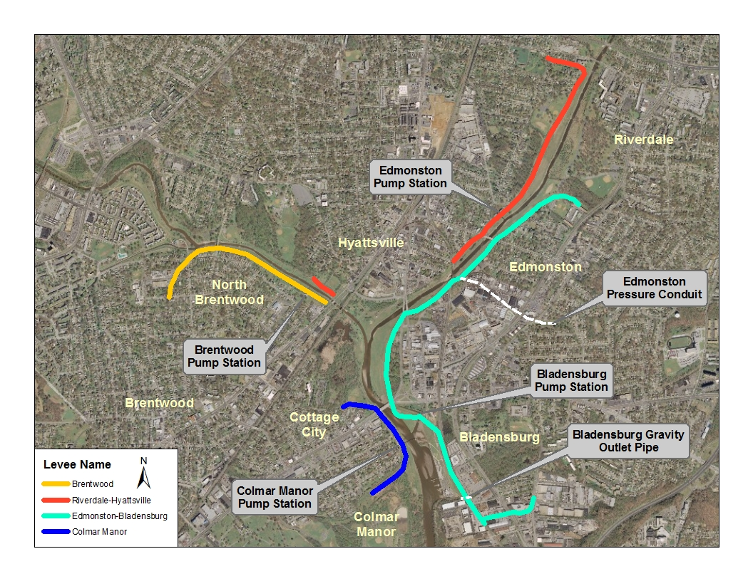
Anacostia Flood Risk Management
Rehabilitation Project

Slide 9
Anacostia Flood Risk Management
Rehabilitation Project
2005 Hurricane Katrina caused catastrophic failure of the levees in New Orleans
USACE initiated nationwide evaluation of all levee systems
2009 the County was notified that the Flood Control project would not meet the standards for FEMA accreditation

Slide 10
Anacostia Flood Risk Management
Rehabilitation Project
Project goals:
Highest priority was to improve Levee safety
Bring levees into conformance with current standards
Obtain certification within timetable established by FEMA to avoid mandatory flood insurance requirement

Slide 11
Anacostia Flood Risk Management
Rehabilitation Project
Timeline
2008 – Identified Deficiencies
2009 - Initiated Preliminary Design
2011 - Started Construction
2013 - Obtained Levee Certification

Slide 12
Anacostia Flood Risk Management
Rehabilitation Project
Levee Assessment included:
  Hydrologic and hydraulic analyses
  Interior drainage study
  Comprehensive assessment of pumping stations
  Geotechnical testing and evaluation
  Comprehensive inspection and evaluation of levees and all levee penetrations

Slide 13
Anacostia Flood Risk Management
Rehabilitation Project
Concept Design Report identified deficiencies and preliminary alternatives to correct deficiencies.
Primary goal is Safety Enhancement and Flood
Protection
Water quantity control mandated for flood control
Alternatives considered included parapet wall and/or
mechanically stabilized techniques, but these were
eliminated due to costs and impacts to park and trail
system

Slide 14
Anacostia Flood Risk Management
Rehabilitation Project
Environmental Agency Coordination:
USACE
Chesapeake Bay Critical Area Commission
Maryland Department of Environment
  Dam Safety Division
  Regulatory Review/Nontidal Wetlands and Waterways Program
Maryland Department of Natural Resources, Wildlife Service
Maryland Historic Trust
U.S. Department of Fish and Wildlife Service
Soil Conservation District
Stormwater Management Concept and Technical Review

Slide 15
Anacostia Flood Risk Management
Rehabilitation Project
Separate Construction Contracts developed included:
Levee Rehabilitation Contract
Pumping Stations and Gravity Outfall Repairs
Pressure Conduit Improvements
Steep Slope Repair

Slide 16
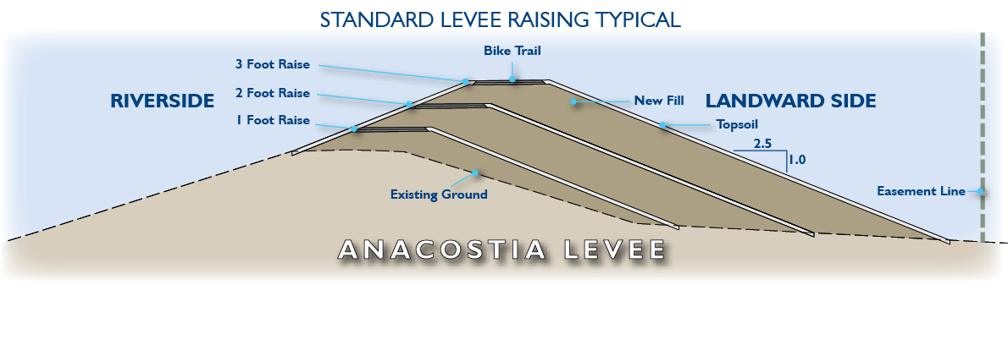
Anacostia Flood Risk Management
Rehabilitation Project
Levee Rehabilitation Contract

Slide 17
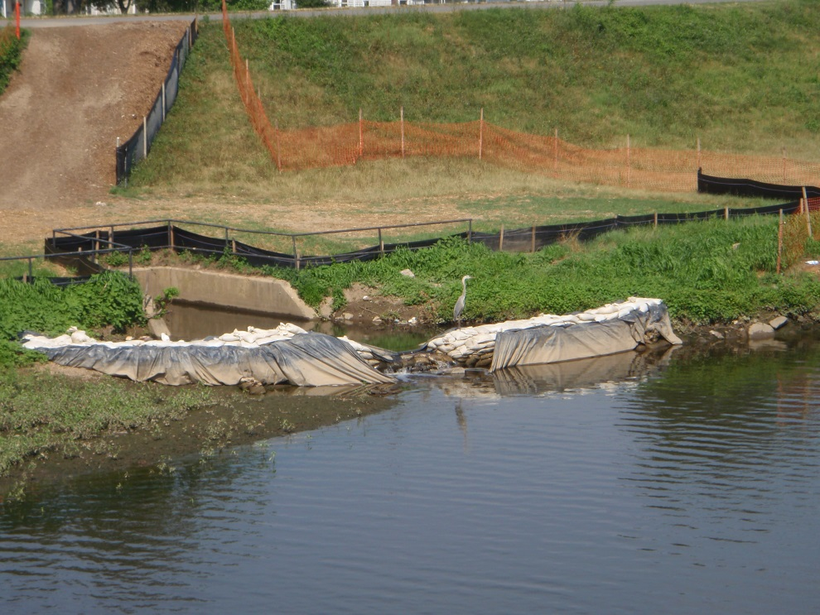
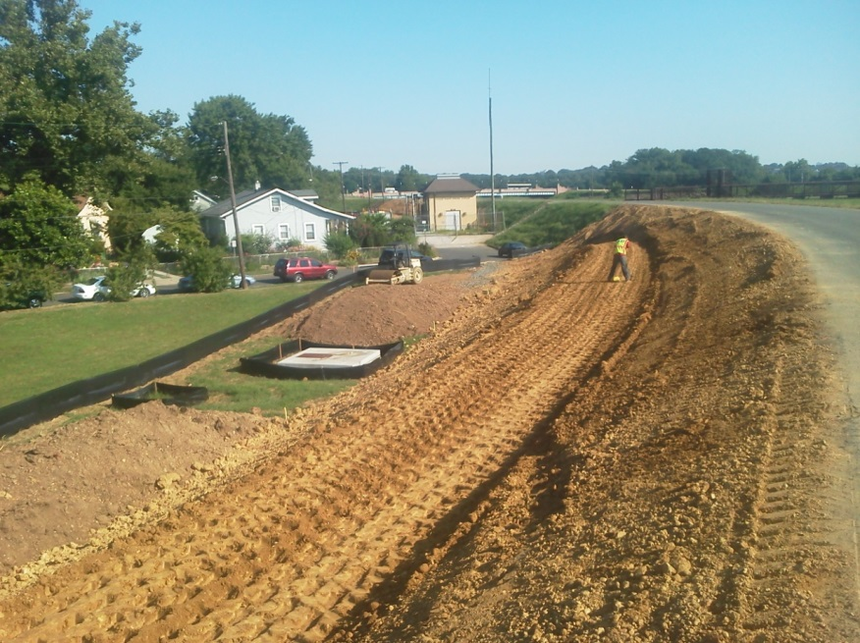
Anacostia Flood Risk Management
Rehabilitation Project

Slide 18
Anacostia Flood Risk Management
Rehabilitation Project
As a result of community concerns regarding use of rip-rap, and extensive coordination with the local municipalities and elected officials DPW&T was able to:
Modify the design and retain the use of grass slopes
to fullest extent possible
DPW&T purchased specialized equipment to allow for maintenance on the steep slopes.

Slide 19
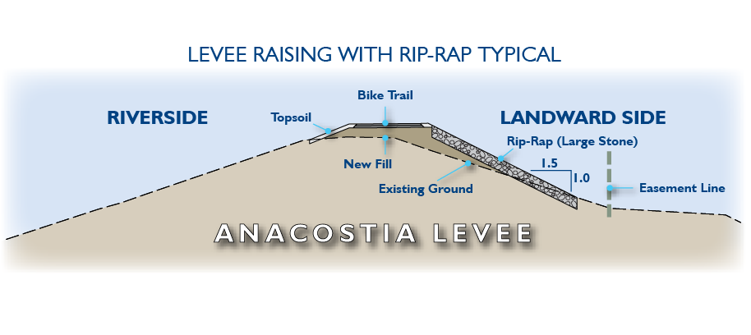
Anacostia Flood Risk Management
Rehabilitation Project

Slide 20
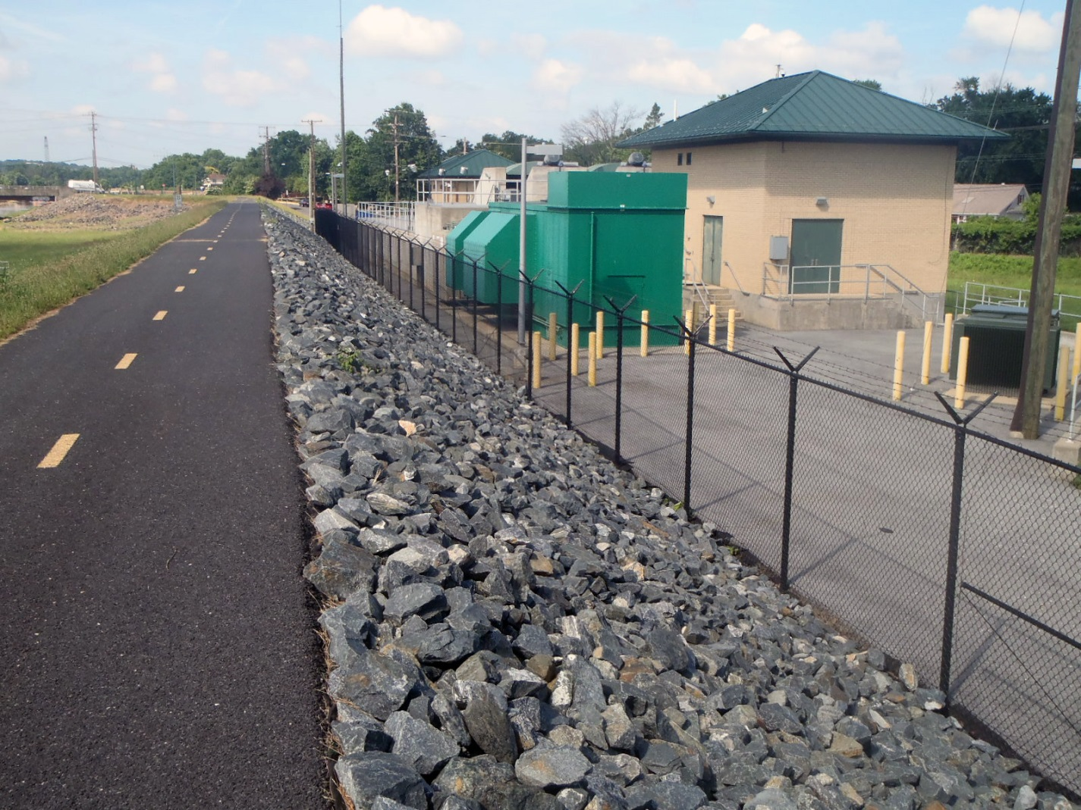
Anacostia Flood Risk Management
Rehabilitation Project

Slide 21
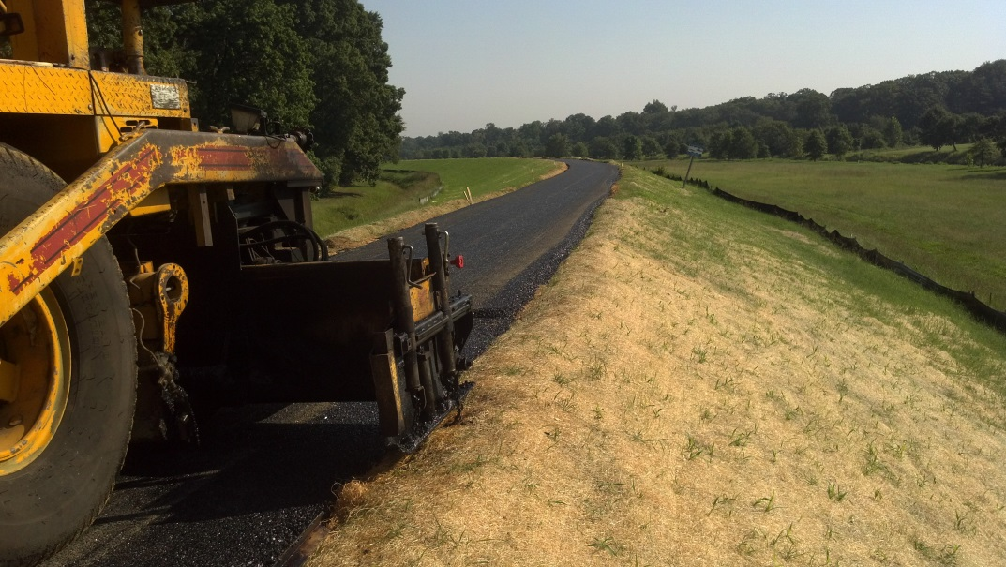
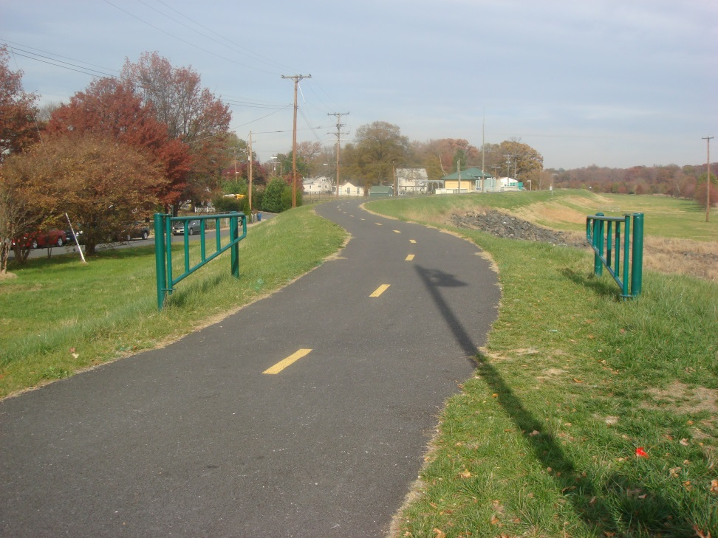
Anacostia Flood Risk Management
Rehabilitation Project

Slide 22
Anacostia Flood Risk Management
Rehabilitation Project
Pumping Stations Repairs
Flood Control Operations had to be maintained during construction which required a complex sequence of construction
The work areas were under tidal influence so creating a dry work area was not easy.

Slide 23
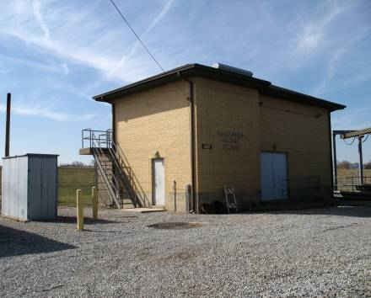
Anacostia Flood Risk Management
Rehabilitation Project
Bladensburg Pumping Station
Sluice gate replacement
New maintenance sluice gate
installation at outfall and intake
areas (Gates control water flow
in and out of river.)
Concrete repairs

Slide 24
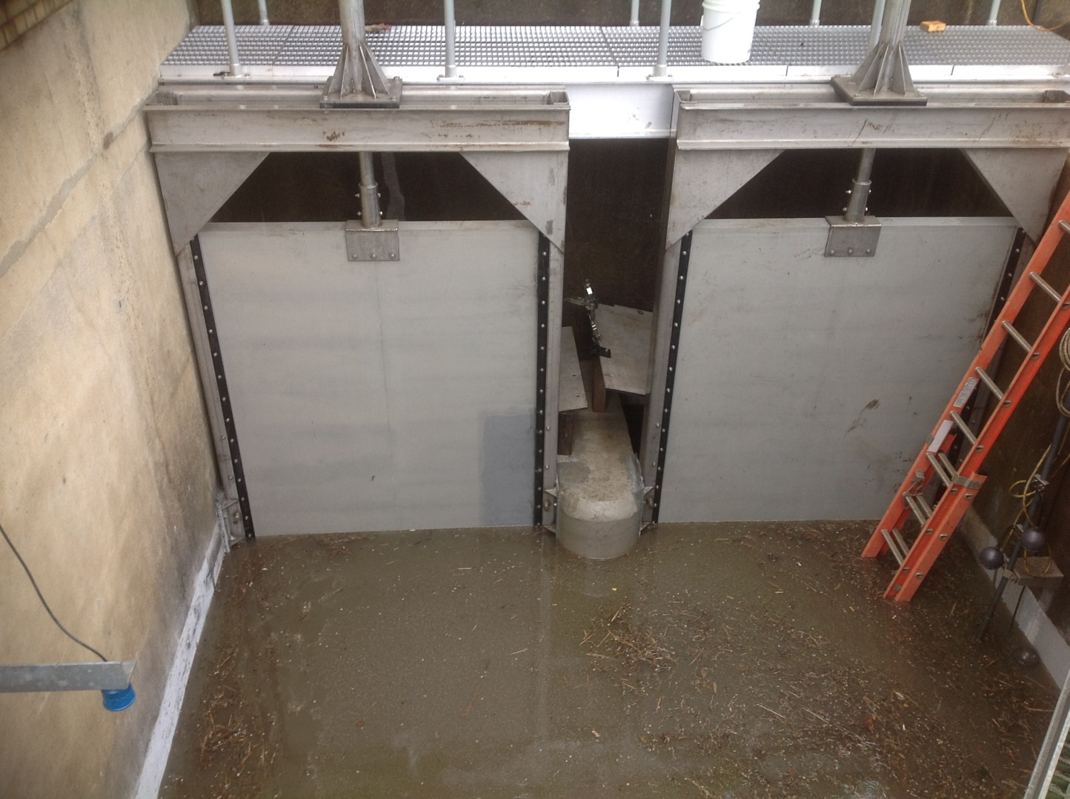
Anacostia Flood Risk Management
Rehabilitation Project

Slide 25
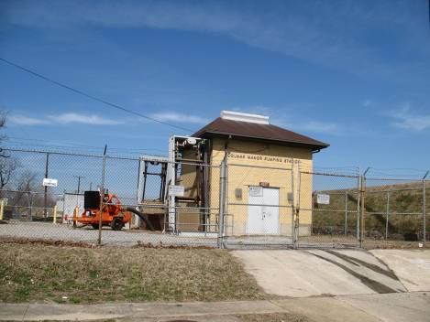
Anacostia Flood Risk Management
Rehabilitation Project
Colmar Manor Pumping Station
Vault/access rehabilitation
Sluice gate replacement
New maintenance sluice gate
installation at the outfall area
(Gates control the water flow
in and out of river.)

Slide 26
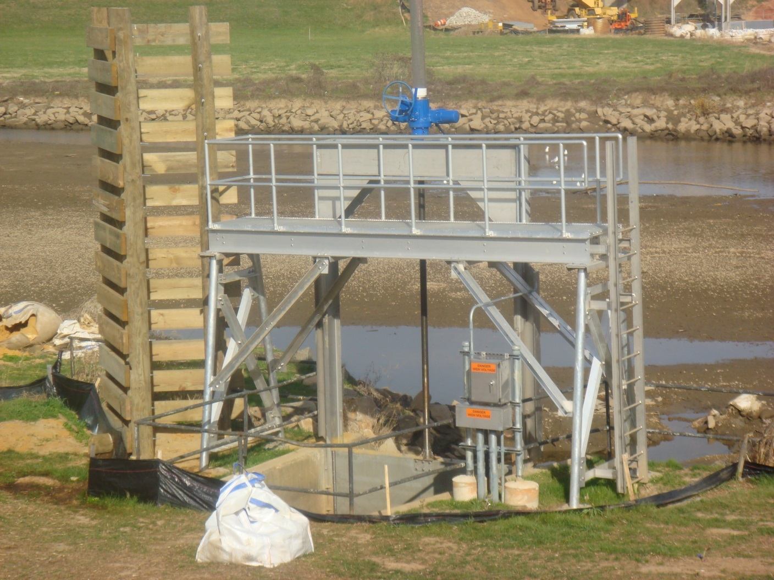
Anacostia Flood Risk Management
Rehabilitation Project

Slide 27
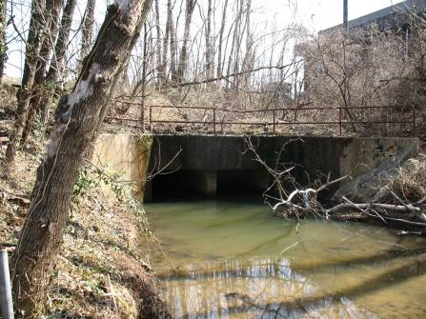
Anacostia Flood Risk Management
Rehabilitation Project
Gravity Outfall Repairs
Concrete Repairs to twin culvert under tidal influence.

Slide 28
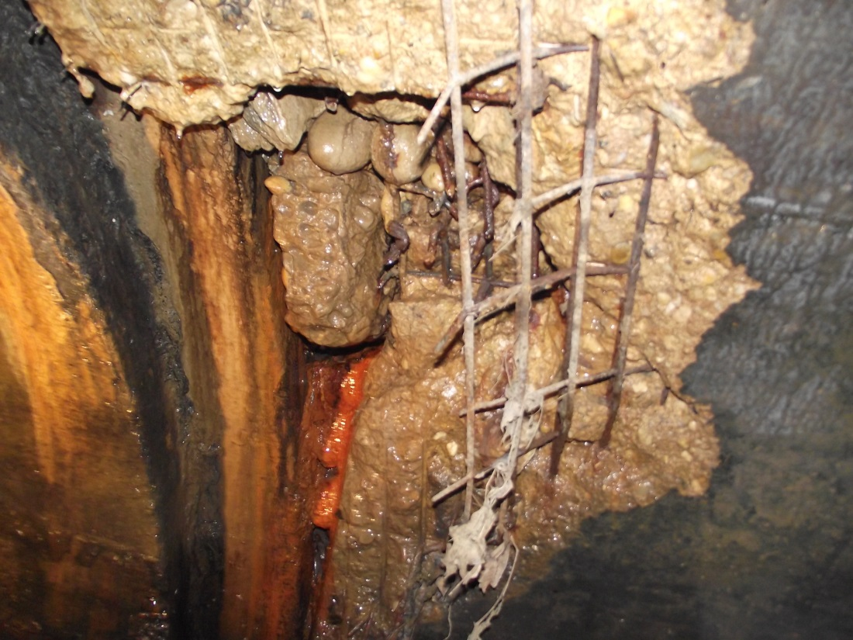
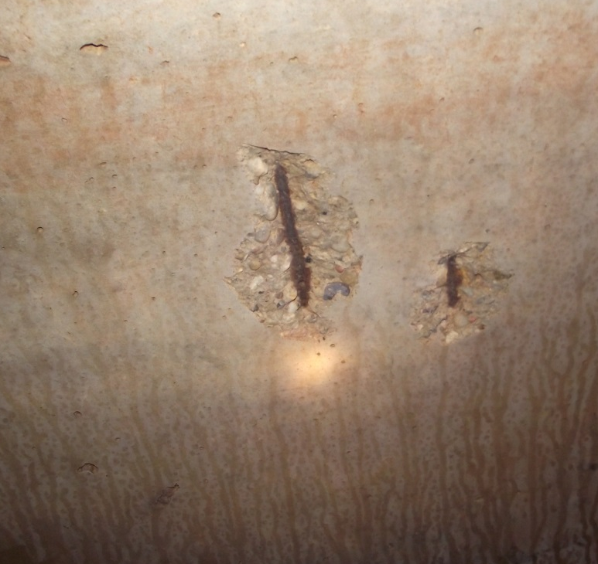
Anacostia Flood Risk Management
Rehabilitation Project

Slide 29
Anacostia Flood Risk Management
Rehabilitation Project
Pressure Conduit Improvements
2500 linear feet of 8x4 Twin Pressure Conduit
Replaced two original access vaults
Installed three new access vaults to improve
maintenance
Installed outfall sluice gate to control tide during
maintenance efforts
Performed concrete repairs

Slide 30
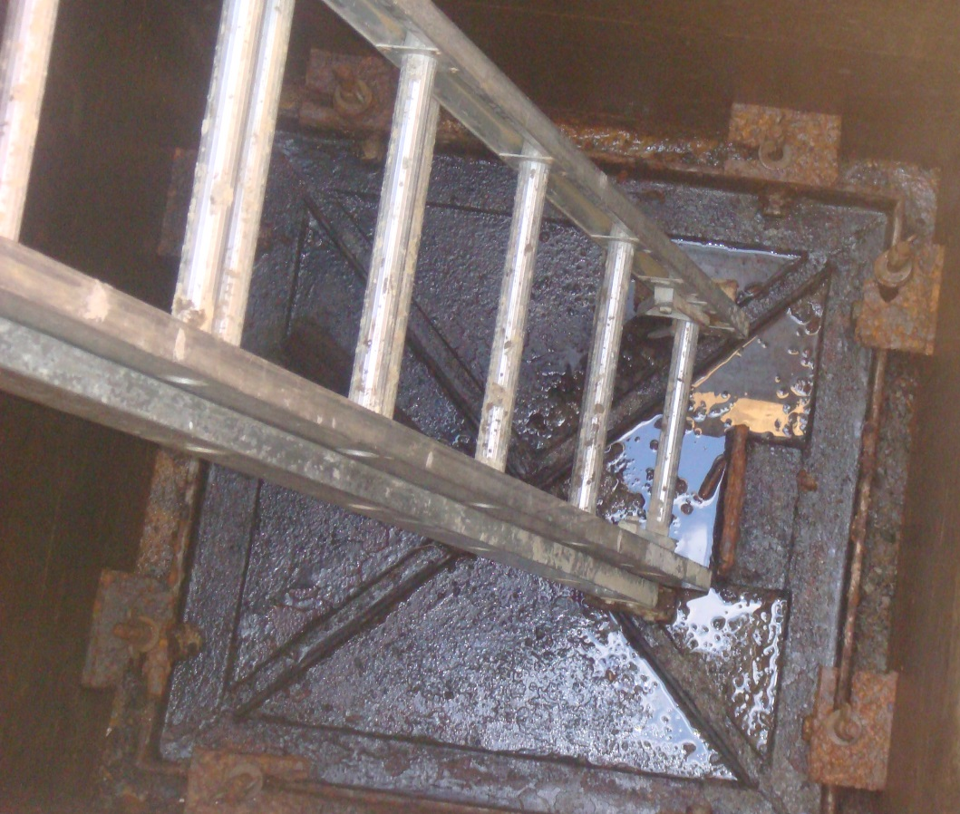
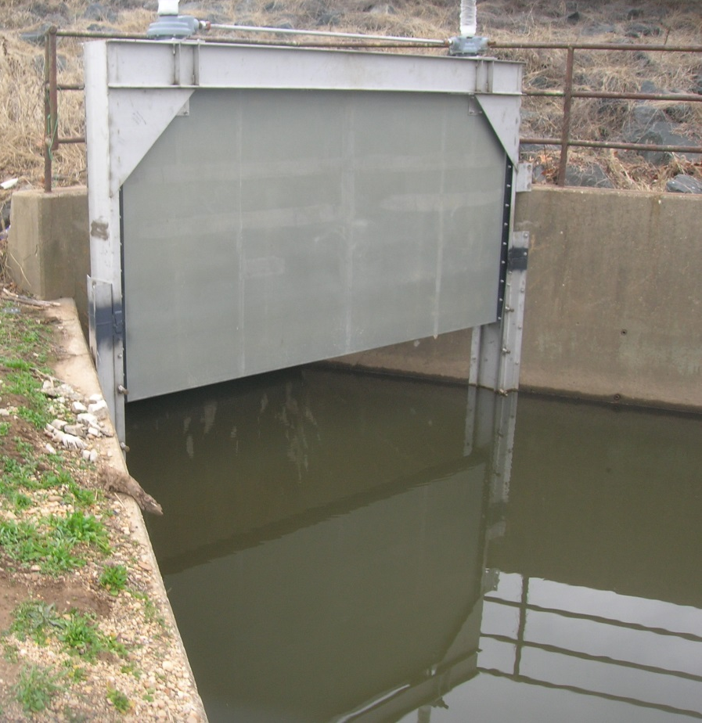
Anacostia Flood Risk Management
Rehabilitation Project

Slide 31
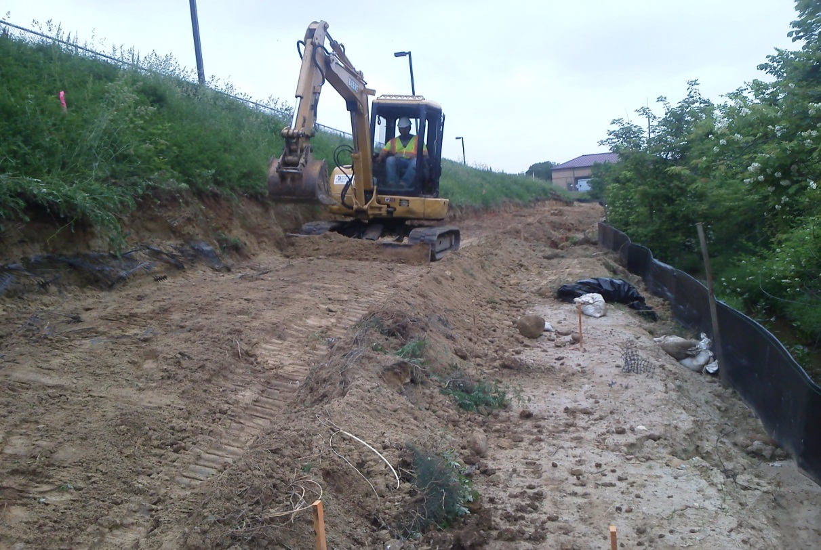
Anacostia Flood Risk Management
Rehabilitation Project
Steep Slope Repair
Landward slope next to the
access road within the Park
was non-compliant
due to steep slopes.
Maintenance was dangerous
Resulting in excessive vegetation

Slide 32
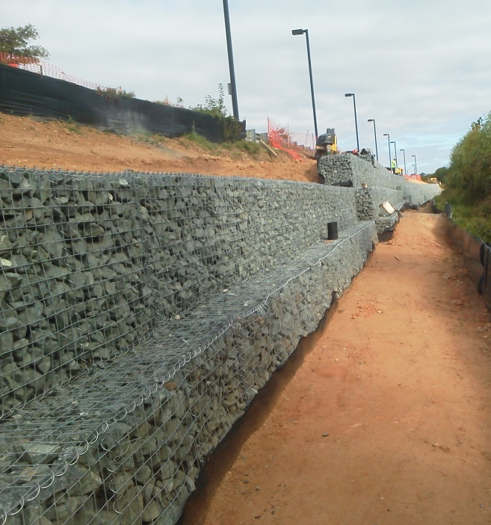
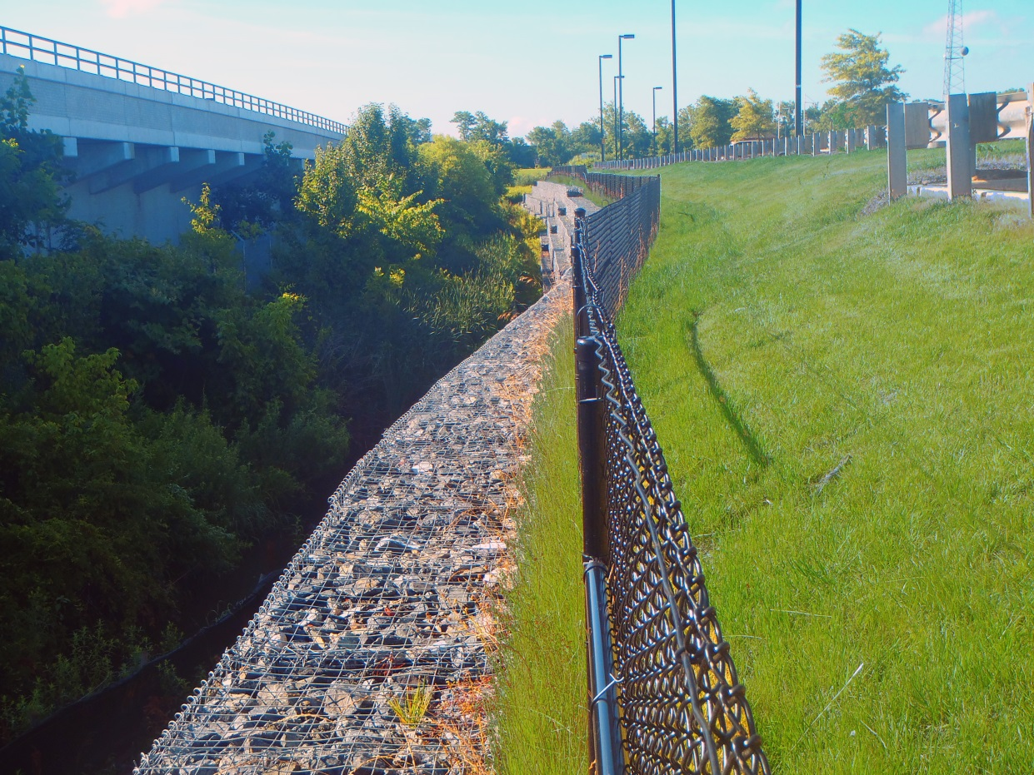
Anacostia Flood Risk Management
Rehabilitation Project

Slide 33
Anacostia Flood Risk Management
Rehabilitation Project
Sustainability
Comprehensive 2 year, 5 year, and 10 year maintenance program to improve system reliability.
Updated Operations and Maintenance Manual and Protocols.

Slide 34

Anacostia Flood Risk Management
Rehabilitation Project
Project was a success.
Over 1,350 property
owners have improved
protection

Slide 35
Anacostia Flood Risk Management
Rehabilitation Project
Summary
Assessment Completed
Concept Design Report Developed Alternatives
Improvement Projects Designed and Constructed
Levee Rehabilitation
Pumping Station and Gravity Outfall Repairs
  Pressure Conduit
  Steep Slope Repair
Provided Long-Term Sustainability

Slide 36
Anacostia Flood Risk Management
Rehabilitation Project
Questions?

